Slide 1

Types of Leadership The Sporty 4
Chris Diacono
Marcel Englmaier
Aaron Huntoon
Andrew Horner

Slide 2
Introduction
Born leaders don’t exist
Leadership is acquired through development
Leadership philosophy
Surroundings
Life
Education
People
Jobs

Slide 3
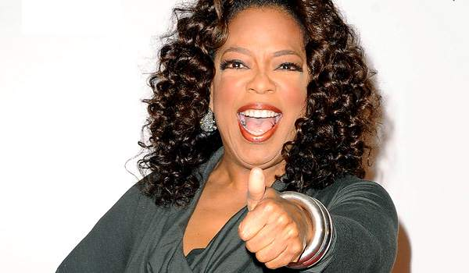
Charismatic Leadership
Notes:
http://www.nwlink.com/~donclark/leader/LMCC.html

Slide 4
Charismatic
Primary Characteristics:
Influences others through power of personality
Energetic, motivating
Inspires passion
Self rather than team

Slide 5
When is it used?
Used in situations when action is needed
Spur others to do stuff
Expand Organization’s position
Stock market
Marketplace
Raise Team morale
Notes:
http://www.brighthubpm.com/resource-management/75686-examples-of-when-to-use-autocratic-leadership/

Slide 6
Applications of Charismatic Leadership
When you need to motivate
When work involves using emotions
When you need to appeal to people

Slide 7
Pros
Evokes emotion
Can cause overnight improvement
Can motivate
Geared towards single people

Slide 8
Cons
Can lead to misdirection
Must be paired with another style to be truly effective
Caters to individuals rather than team
Notes:
http://leadershipzone.wordpress.com/2013/12/01/high-risk-commanding-leadership-styles/

Slide 9

Autocratic Leadership
Notes:
http://www.nwlink.com/~donclark/leader/LMCC.html

Slide 10
Authoritarian Leadership “Individual Control”
Primary Characteristics:
Little to no input from other members
Leaders make all decisions
Group leader dictates methods and procedures
Members are not trusted to make decisions

Slide 11
When is it used?
Used in situations where control is necessary
Little margin for error
Dangerous conditions
Used when workforce displays Type x behavior
When people naturally dislike working
Need close management supervision
During times of emergency
Need for quick decisions
Notes:
http://www.brighthubpm.com/resource-management/75686-examples-of-when-to-use-autocratic-leadership/

Slide 12
Applications of Autocratic Leadership
Where precision of work is to exact specification (military and during surgery)
When work involves high level of risk or technicality
When organization is constantly changing and requires instant decisions to be made
To manage an extremely large group

Slide 13
Pros
Making decisions quickly without consultation
Allows leader to take charge of group
Establish deadlines
Assign tasks to members
Members focus on specific task vs. complex
Streamlined work process
Less need for layers of management
More efficient

Slide 14
Cons
Leaders become to controlling and dictatorial
Often leads to resentment from members
Lack of creative solutions to problems
Members are not able to contribute ideas
Leader dependence
Notes:
http://leadershipzone.wordpress.com/2013/12/01/high-risk-commanding-leadership-styles/

Slide 15

Laissez-Faire

Slide 16
Primary Characteristics
Non-authoritarian and “Hands off” style.
Gives general guidance but doesn’t demand.
Lets people respond in their own ways to situations.
Followers have freedom.

Slide 17
When is it used?
When leaders have people below them that know how to do their job.
Leader has confidence and trusts their worker.
When workers are highly skilled and motivated

Slide 18
Pros
Workers feel more satisfied because they solve their own problems
Lets workers open up and try new creative ideas
Makes everyone feel more responsible and accountable for their work.

Slide 19
Cons
Unexperienced and new workers can feel lost.
Some workers are not motivated.
Makes leader seem uninvolved and lazy.
Projects can go off track and miss deadlines.

Slide 20


Transformational Leadership

Slide 21
What is it?
Inspires positive change
Energetic, Enthusiastic and Passionate
Helps every member of the group to be successful
Sets clear goals
Has high expectations
Encourages others

Slide 22
Components of transformational leadership
Intellectual Stimulation
Encourage creativity among followers, and explore new ways of doing things and new opportunities to learn
Individualized Consideration
Offering support and encouragement to others, keeps lines of communication open to share new ideas
Inspirational Motivation
Clear vision to communicate with others, helps followers experience passion and motivation to achieve these goals
Idealized Influence
Serves as a role model to followers, and they imitate the leader due to their trust and respect

Slide 23
Assumptions and behaviors
Assumptions
People will follow a leader that inspires them
A person with vision and passion can achieve great things
Energy and Enthusiasm are key to getting things done
Behaviors
Expects team to transform no matter what
Counts on everyone giving their best
Serves as a role model for all involved

Slide 24
Uses and impact on others
When to use it
Encourage the group to pursue innovative and creative ideas and actions
Motivate the group through team optimism, enthusiasm and commitment
Impact on others
Can lead to high productivity and engagement from all members
Effective at creating enthusiastic working environment
Can be time consuming
Lacks details for application

Slide 25
References & Questions
Cherry, K. (2014). How Do Transformational Leaders Inspire?. about education. Retrieved September 27, 2014 from http://psychology.about.com/od/leadership/a/transformational.htm
Cherry, K. (2014). What is Autocratic Leadership?. In about education. Retrieved September 30, 2014, from http://psychology.about.com/od/leadership/f/autocratic-leadership.htm
Cherry, K. (2014). What Is Laissez-Faire Leadership? The Pros and Cons of the Delegate Leadership Style. Retrieved September 29, 2014, from http://psychology.about.com/od/leadership/f/laissez-faire-leadership.htm
Joseph, C. (2014). Advantages of Autocratic Leadership Style. In Small Business. Retrieved September 30, 2014, from http://smallbusiness.chron.com/advantages-autocratic- leadership-style-2980.html
Travis, E. (2010, December 31). The Disadvantages of Transformational Leadership. eHow. Retrieved September 27, 2014, from http://www.ehow.com/info_7749368_disadvantages-transformational- leadership.html

